Slide 1

COP 6731: Theory and Implementation of Database Systems
Transaction Processing

Slide 2
Outline
Goal:
Understand the basic concept of transaction processing

Slide 3
Introduction to Transaction Processing
Single-User System:
At most one user at a time can use the system.
Multiuser System:
Many users can access the system concurrently.
Concurrency
Interleaved processing:
Concurrent execution of processes is interleaved in a single CPU
Parallel processing:
Processes are concurrently executed in multiple CPUs.

Slide 4
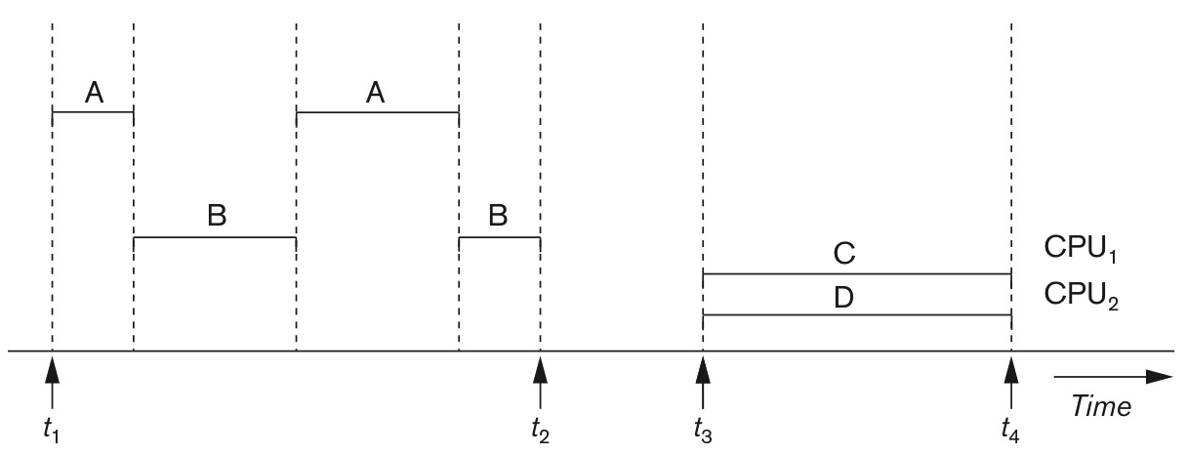
Concurrent Transaction
Interleaved processing
Parallel processing

Slide 5
Introduction to Transaction Processing
A transaction is a series of actions, carried out by a single user which accesses or changes the contents of the database
Transaction (set of operations) :
logical unit of database processing that includes one or more access operations (e.g., insert, select, update, and delete).
Transaction boundaries:
Begin and End transaction.
Application program may contain several transactions separated by Begin and End transaction boundaries.

Slide 6
Introduction to Transaction Processing
Consider Simple Model of a Database (for purposes of discussing transactions):
A database is a collection of named data items
Granularity: the size of data item (e.g., field, record, disk block, table, or database)
Two basic database operations: Read and Write
read_item(X): Reads data item X into a program variable X.
write_item(X): Writes the value of program variable X into data item X.

Slide 7
Introduction to Transaction Processing
READ AND WRITE OPERATIONS:
Basic unit of data transfer from disk to buffer cache (or main memory) is disk block.
read_item(X) includes the following steps:
Find address of disk block that contains item X.
Copy that disk block into buffer cache (if that disk block is not already in buffer cache).
Copy item X from buffer cache to program variable X.
write_item(X) includes the following steps:
Find address of disk block that contains item X.
Copy that disk block into buffer cache (if that disk block is not already in buffer cache).
Copy item X from program variable X into its correct location in buffer cache.
Store the updated block from buffer cache back to disk block (either immediately or at some later point in time).

Slide 8
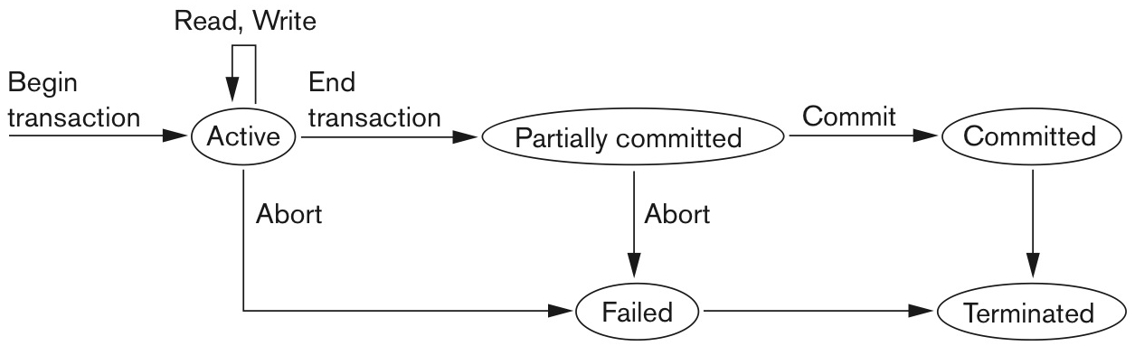
States of transaction execution

Slide 9
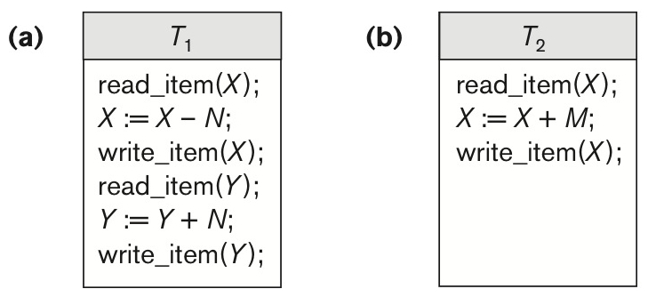
Two Sample Transactions

Slide 10
Introduction to Transaction Processing
Why concurrency control is needed:
Lost Update Problem
Temporary Update (or Dirty Read) Problem
Incorrect Summary Problem

Slide 11
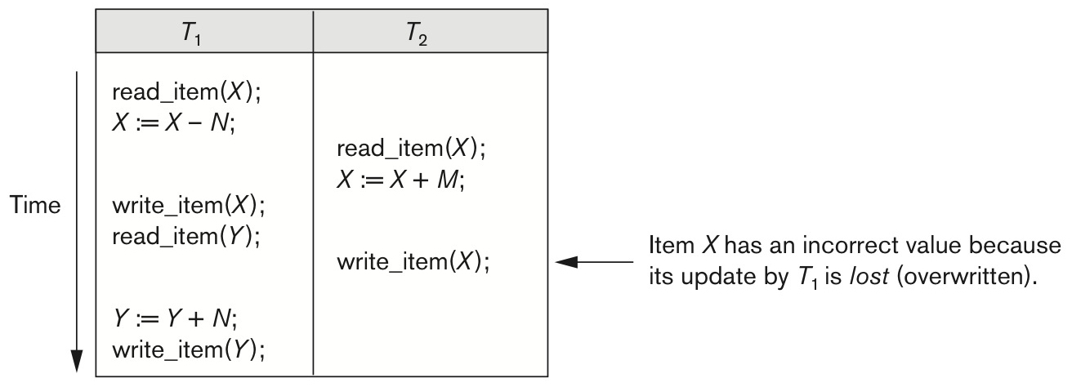
Lost Update
X =100
 | T1 | T1 (Mem) | T2 | T2 (Mem) | Disk
1 | read_item(X) | X=100 |  |  | X=100
2 | X = X - 50 | X=50
3 |  |  | read_item(X) | X=100
4 |  |  | X = X + 50 | X=150
5 | write_item(X) |  |  |  | X=50
6 |  |  | write_item(X) |  | X=150

Slide 12
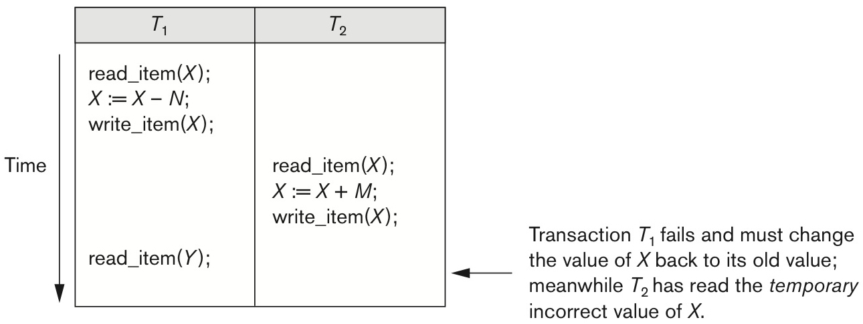
Temporary Update (or Dirty Read)
X =100
 | T1 | T1 (Mem) | T2 | T2 (Mem) | Disk
1 | read_item(X) | X = 100 |  |  | X=100
2 | X = X - 50 | X = 50
3 | write_item(X) |  |  |  | X=50
4 |  |  | read_item(X) | X = 50
5 |  |  | X = X + 50 | X = 100
6 |  |  | write_item(X) |  | X=100
7 | System Crashed (or Abort)

Slide 13
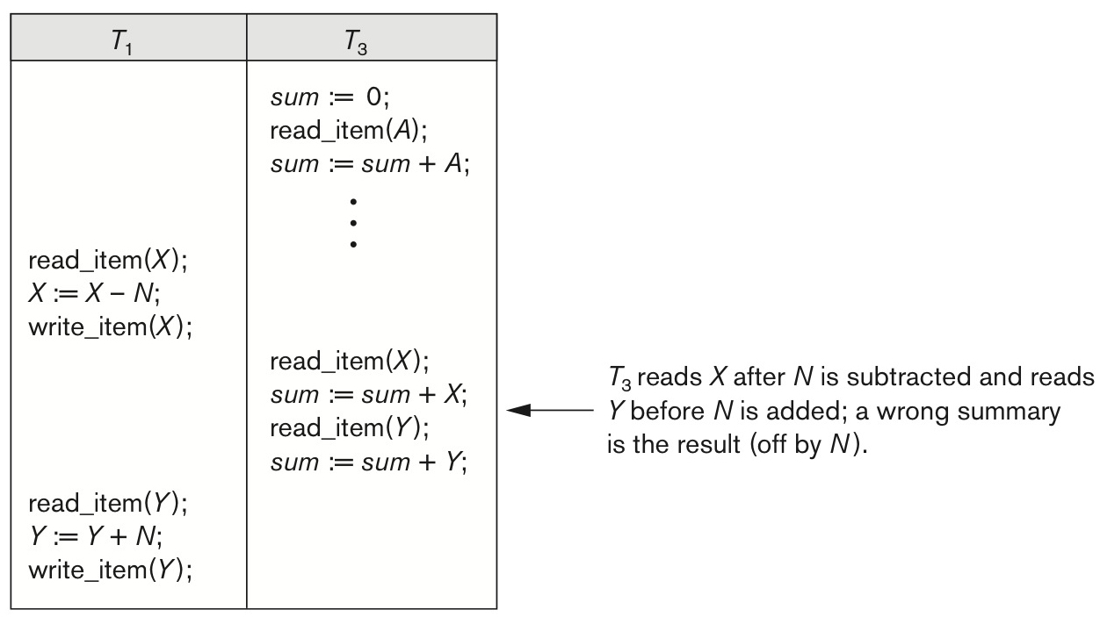
Incorrect Summary

Slide 14
Introduction to Transaction Processing
Why recovery is needed:
(What causes a Transaction to fail)
1. Computer failure (system crash)
2. Transaction or system error
3. Local errors or exception conditions
4. Concurrency control enforcement
5. Disk failure
6. Physical problems and catastrophes

Slide 15
Transaction and System Concepts
A transaction is an atomic unit of work that is either completed in its entirety or not done at all.
Transaction states:
Active state
Partially committed state
Committed state
Failed state
Terminated State

Slide 16
Transaction and System Concepts
Recovery manager keeps track of the following operations:
begin_transaction
a set of read or write operations
end_transaction
commit
rollback (or abort)

Slide 17
Transaction and System Concepts
Log keeps track of all transaction operations that affect the values of database items.
Types of log record:
[start_transaction, T]: Records that transaction T has started execution.
[write_item, T, X, old_value, new_value]: Records that transaction T has changed the value of database item X from old_value to new_value.
[read_item, T, X]: Records that transaction T has read the value of database item X.
[commit,T]: Records that transaction T has completed successfully and affirms that its effect can be committed (recorded permanently) to the database.
[abort,T]: Records that transaction T has been aborted.

Slide 18
Transaction and System Concepts
Force writing a log
Before a transaction reaches its commit point, the log must be written to the disk.
Recovery techniques use the following operators:
Undo
Redo

Slide 19
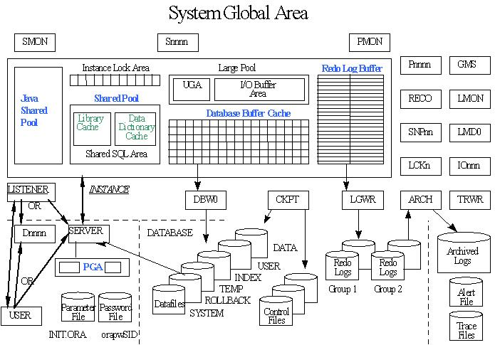
Database Server Architecture

Slide 20
Desirable Properties of Transactions
ACID properties:
Atomicity: A transaction is an atomic unit of processing; it is either performed in its entirety or not performed at all.
Consistency preservation: A correct execution of the transaction must take the database from one consistent state to another.
Isolation: A transaction should not make its updates visible to other transactions until it is committed; this property, when enforced strictly, solves the temporary update problem and makes cascading rollbacks of transactions unnecessary.
Durability or permanency: Once a transaction changes the database and the changes are committed, these changes must never be lost because of subsequent failure.

Slide 21
Schedule
Schedule S of n transaction T₁, T₂, … T_{n} is an ordering of the operations of the transactions.
S : R1(X),W1(X),R2(X),W2(X),R1(Y)

Slide 22
Serial Schedule
Serial schedule:
Only one transaction at a time in active.
No interleaving occurs.

Slide 23
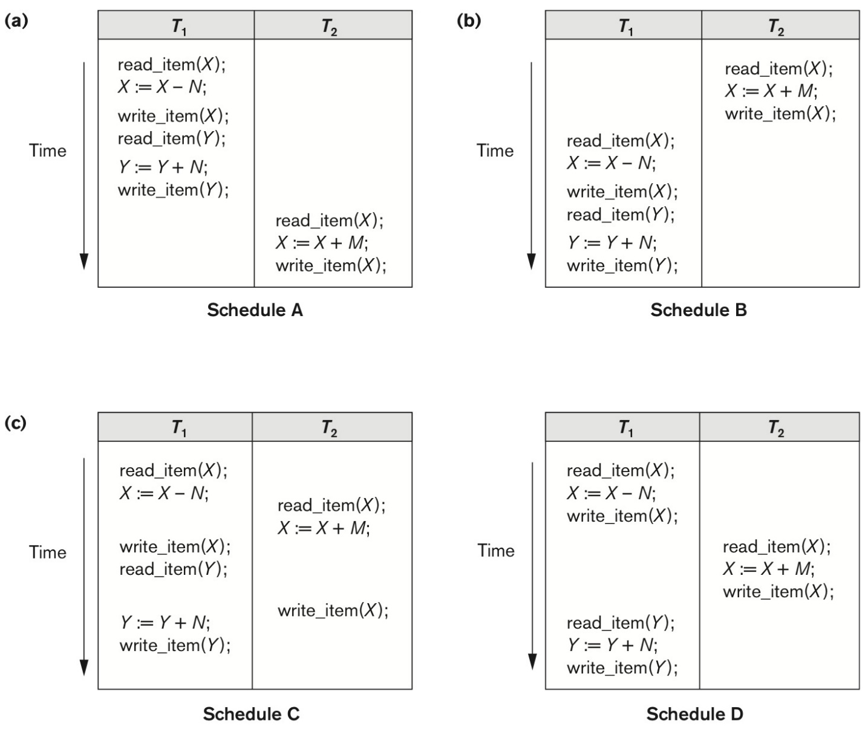
(Serial Schedule)
(Serial Schedule)

Slide 24
Serializable Schedule
Two operations in a schedule are conflict if they satisfy all three following conditions:
They belong to different transactions
They access the same item X
At least one of the operations is a write_item(X)
There are two types of conflict:
1) read-write (or write-read) conflict
2) write-write conflict.

Slide 25
Serializable Schedule
A schedule S is serializable if it is equivalent to some serial schedule.
Conflict equivalent:
Two schedules are said to be conflict equivalent if the order of any two conflicting operations is the same in both schedules.
A schedule S is conflict serializable if it is conflict equivalent to some serial schedule.

Slide 26
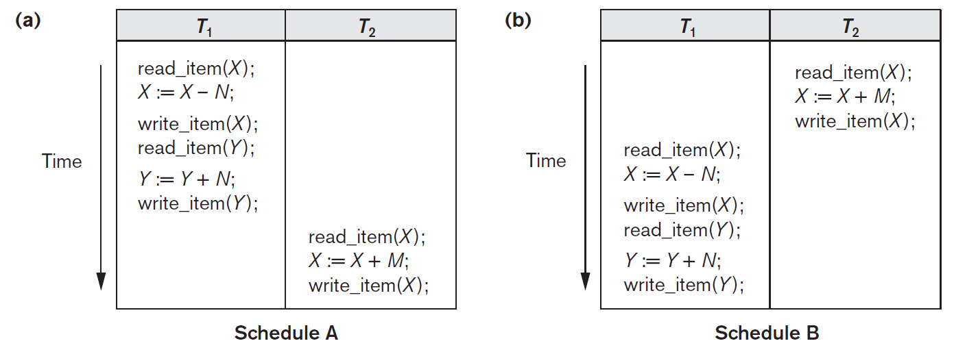
Serial Schedule

Slide 27
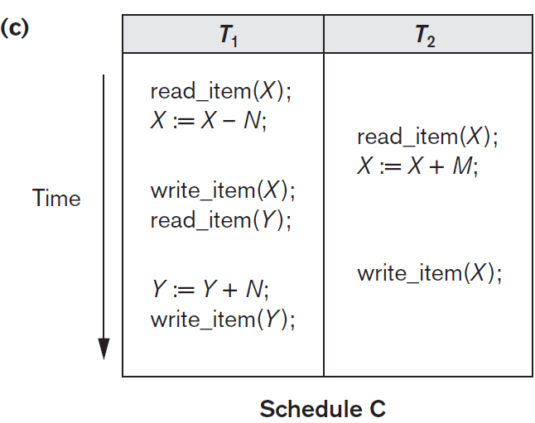
Serialization Graph (Precedence Graph)

Slide 28
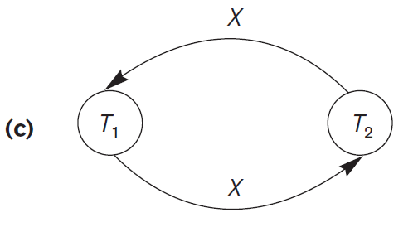
Serialization Graph (Precedence Graph)

Slide 29
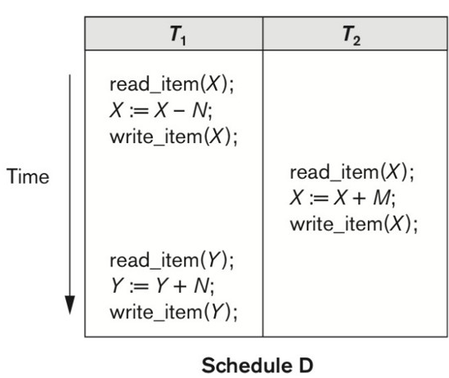
Is it conflict-serializable?

Slide 30
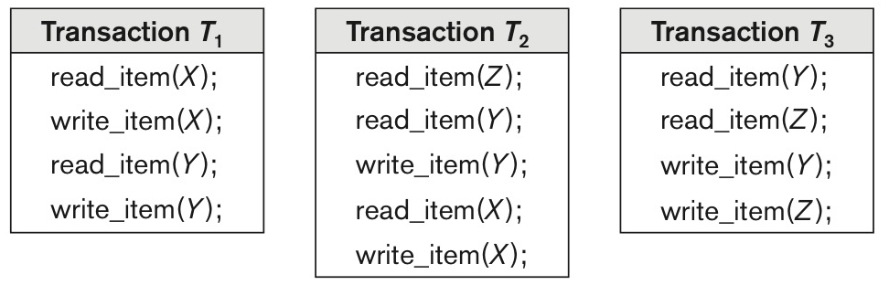
Conflict-serializable?

Slide 31
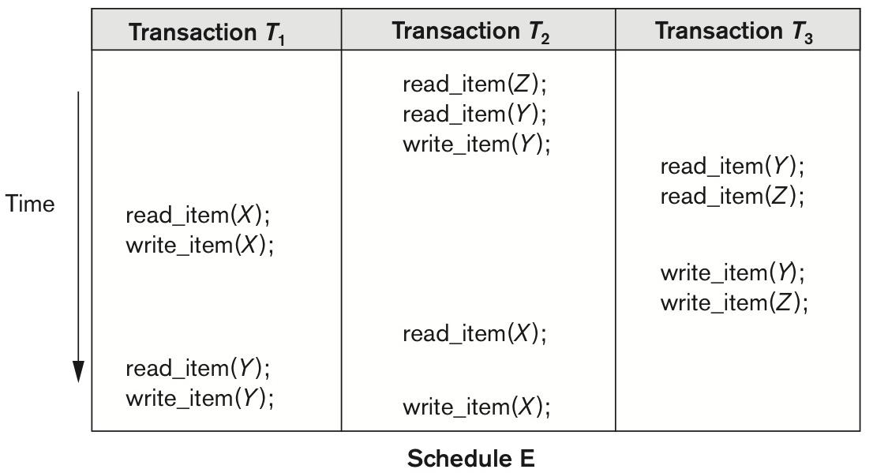
Is it conflict-serializable?

Slide 32
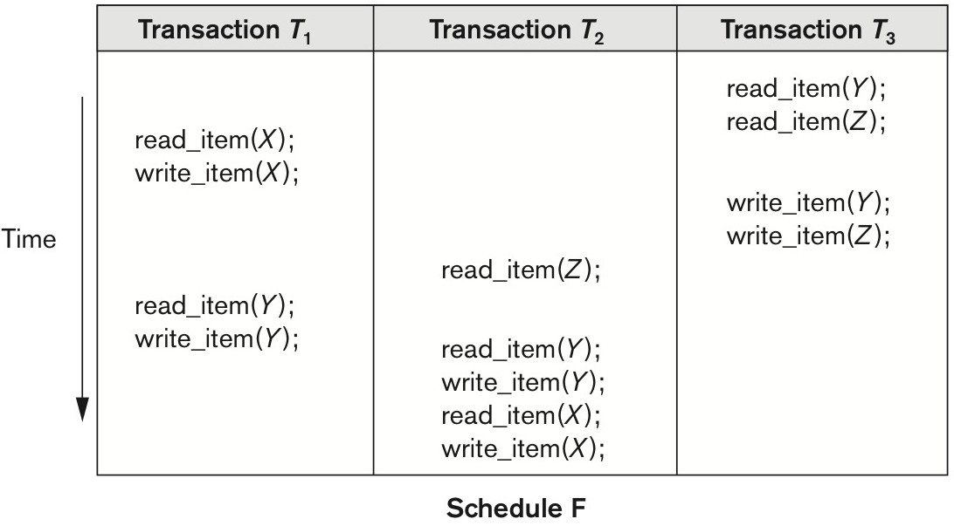
Is it conflict-serializable?

Slide 33
Serializable Schedule
Serializability is hard to check.
It’s not possible to determine when a schedule begins and when it ends
Practical approach: Two-phase locking

Slide 34
Recoverable Schedule
Recoverable schedule:
Once a transaction is committed, it should never be necessary to roll back.
A schedule is recoverable if no transaction T1 in S commits until all transactions T2 that have written some item X that T1 reads have committed.
W2(X),R1(X),C2,C1
T1 | T2
 | Write(X)
Read(X)
 | Commit;
Commit

Slide 35
Recoverable Schedule
S : R1(X),R2(X),W1(X),R1(Y),W2(X),C2,W1(Y),C1
T1 | T2
Read(X)
 | Read(X)
Write(X)
Read(Y)
 | Write(X)
 | Commit
Write(Y)
Commit
Is it Recoverable Schedule?

Slide 36
Recoverable Schedule
S : R1(X),W1(X),R2(X),R1(Y),W2(X),C2,A1
T1 | T2
Read(X)
Write(X)
 | Read(X)
Read(Y)
 | Write(X)
 | Commit
Abort
Is it Recoverable Schedule?

Slide 37
Recoverable Schedule
S : R1(X),W1(X),R2(X),R1(Y),W2(X),W1(Y),C1,C2
T1 | T2
Read(X)
Write(X)
 | Read(X)
Read(Y)
 | Write(X)
Write(Y)
Commit
 | Commit
Is it Recoverable Schedule?

Slide 38
Recoverable Schedule
S : R1(X),W1(X),R2(X),R1(Y),W2(X),W1(Y),A1,A2
T1 | T2
Read(X)
Write(X)
 | Read(X)
Read(Y)
 | Write(X)
Write(Y)
Abort1
 | Abort2
Is it Recoverable Schedule?

Slide 39
Recoverable Schedule
Schedules requiring cascaded rollback:
A schedule in which uncommitted transactions that read an item from a failed transaction must be rolled back.
Cascadeless schedule:
Every transaction reads only items that were written by committed transactions.
Strict Schedules:
A schedule in which a transaction can neither read nor write an item X until the last transaction that wrote X has committed.

Slide 40
Transaction Support in SQL2
A single SQL statement is always considered to be atomic.
Either the statement completes execution without error, or it fails and leaves the database unchanged.
With SQL, there is no explicit Begin Transaction statement.
Transaction initiation is done implicitly when any SQL statement is executed.
Every transaction must have an explicit End statement, which is either a COMMIT or ROLLBACK.

Slide 41
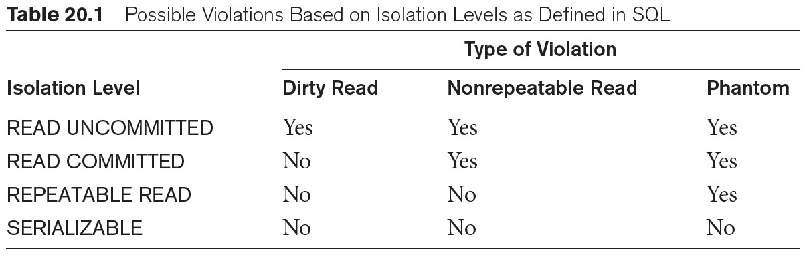
Isolation Level

Slide 42
Type of Violations
Dirty Read – A Dirty read is the situation when a transaction reads a data that has not yet been committed. For example, Let’s say Transaction 1 updates a row and leaves it uncommitted, meanwhile, Transaction 2 reads the updated row. If Transaction 1 rolls back the change, Transaction 2 will have read data that is considered never to have existed.
Non-Repeatable read – A Non-Repeatable read occurs when a transaction reads same row twice and get a different value each time. For example, suppose Transaction T1 reads data. Due to concurrency, another Transaction T2 updates the same data and commit. Now if Transaction T1 reads again the same data, it will retrieve a different value.
Phantom Read – A Phantom Read occurs when two same queries are executed, but the rows retrieved by the two queries, are different. For example, suppose Transaction T1 retrieves a set of rows that satisfy some search criteria. Now, Transaction T2 generates some new rows that match the search criteria for Transaction T1. If Transaction T1 re-executes the statement that reads the rows, it gets a different set of rows this time.

Slide 43
Isolation Level
Read Uncommitted – Read Uncommitted is the lowest isolation level. In this level, one transaction may read not yet committed changes made by other transaction, thereby allowing dirty reads. In this level, transactions are not isolated from each other.
Read Committed – This isolation level guarantees that any data read is committed at the moment it is read. Thus, it does not allow dirty reads. The transaction holds a read or write lock on the current row, and thus prevent other transactions from reading, updating or deleting it.
Repeatable Read – This is the most restrictive isolation level. The transaction holds read locks on all rows it references and writes locks on all rows it inserts, updates, or deletes. Since other transaction cannot read, update or delete these rows, consequently it avoids non-repeatable read.
Serializable – This is the highest isolation level. A serializable execution is guaranteed to be serializable. Serializable execution is defined to be an execution of operations in which concurrently executing transactions appears to be serially executing.

Slide 44
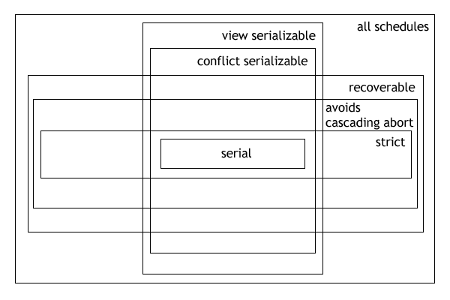
Types of Schedules in DBMS

Slide 45
Summary
Transaction Concepts
Desirable Properties of Transactions
Characterizing Schedules based on Recoverability
Characterizing Schedules based on Serializability
Transaction Support in SQL

